Slide 1
Nurses Stress Prediction Wearable Sensors

Slide 2
Problem Statement
Nurses work in high-stress environments, facing long shifts, emotional strain, and heavy workloads. Prolonged stress leads to burnout, reduced care quality, and impacts their well-being. Early detection of stress is essential for improving both nurse health and patient care.
Wearable sensors offer a non-intrusive way to monitor stress indicators such as:
Heart Rate Variability (HRV)
Electrodermal Activity (EDA)
Respiratory Rate
By utilizing these sensors and applying machine learning, we can predict stress in real-time, enabling timely interventions to support nurse well-being and maintain healthcare quality.

Slide 3

Motivation
Critical Role of Nurses:-
Nurses are essential in healthcare, providing critical patient care under high-pressure conditions.
Consequences of Unmanaged Stress:-
Prolonged stress can lead to burnout, reduced quality of patient care, increased errors, and high nurse turnover rates.
Improving Work Environment:-
A stress prediction model for nurses can enhance work environments, improve well-being, and ensure high-quality patient care.

Slide 4

Literature Review
To ensure a strong foundation for our project, we reviewed key research that explored stress prediction using wearable sensors and machine learning in healthcare settings. Research Paper 1:
Stress Detection in Working People
Sriramprakash.S * , Prasanna Vadana. D, O. V. Ramana Murthy
Research Paper 2:
Multi-CIass Stress Detection Through Heart Rate Variability:
JON ANDREAS MORTENSEN, MARTIN EFREMOV MOLLOV, AYAN CHATTERJEE, DEBASISH GHOSE, (Senior Member, IEEE), AND FRANK Y.LI

Slide 5
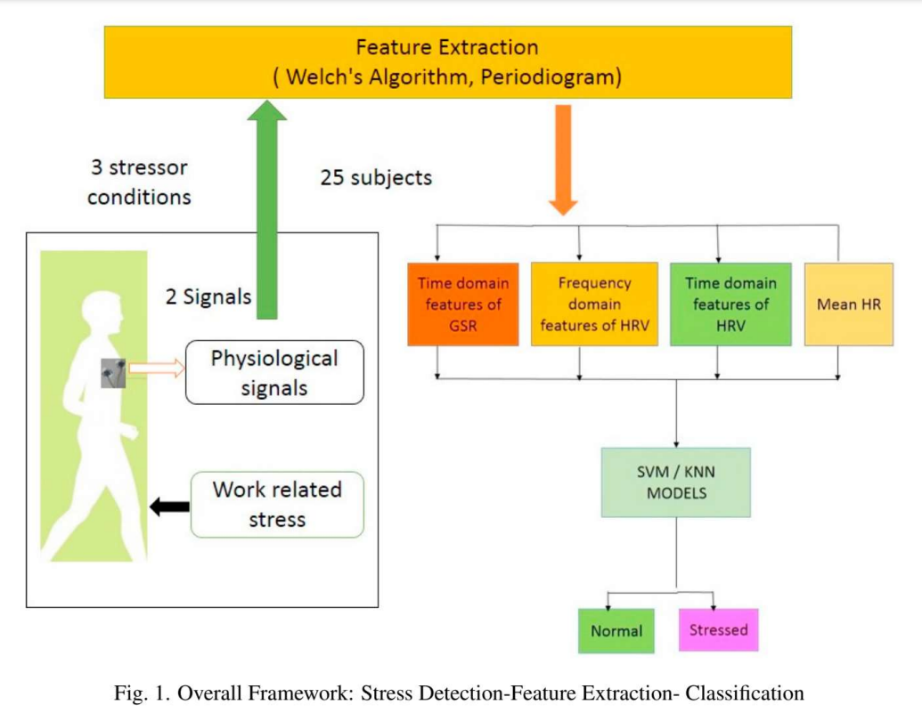
Research Paper 1
Physiological Signals: Data is collected from 25 subjects under three stressor conditions using GSR (Galvanic Skin Response) and HRV (Heart Rate Variability).
Feature Extraction: Key features are extracted using certain algorithms, focusing on time and frequency domain characteristics for both GSR and HRV.
Machine Learning Models: Extracted features are used to train SVM and KNN models.
Classification: The models classify subjects as either Normal or Stressed based on the input features.
Random Forest Achieves the highest accuracy of 91.34%

Slide 6
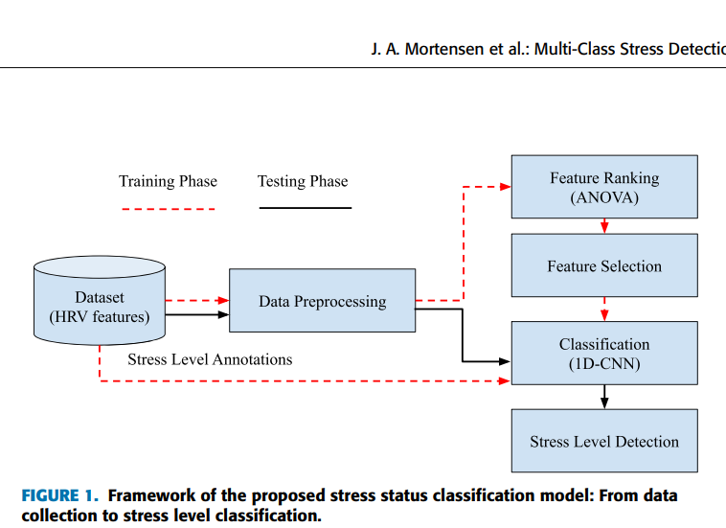
Research Paper 2
Data Collection: HRV signals were gathered from 25 participants during tasks with stressors (email interruptions, time pressure).
Data Preprocessing: Time-series HRV data was cleaned, normalized, and split into training (80%) and testing (20%) sets.
Feature Extraction: Time-domain and frequency-domain features were extracted, and ANOVA F-test was used for feature ranking.
Classification: A 1D CNN model was developed to classify stress into three categories: no stress, time pressure, and interruption.
Feature Optimization: Top features achieved 96.5% accuracy with reduced computational load.

Slide 7
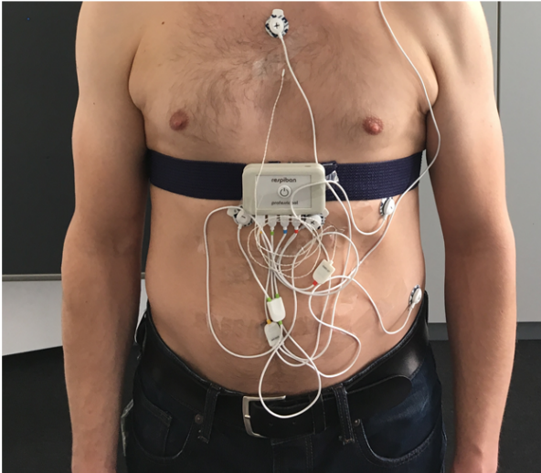
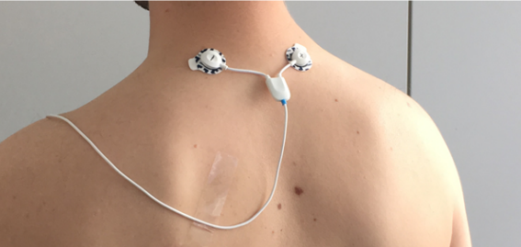
Dataset description
The Swell-KW dataset consists of data from 25 participants who were knowledge workers, collected to study the effects of stress and workload in a controlled work environment. Participants were exposed to three different conditions: low stress, time pressure stress, and interruption stress. Physiological measurements, including heart rate variability (e.g., RMSSD, SDSD), respiration, and other metrics like KURT, SKEW, and their relative variations (REL_RR), were recorded during various work tasks. The dataset also includes self-reported stress and workload assessments, making it valuable for analyzing the relationship between physiological responses and perceived mental states.

Slide 8
Attributes
No. | Feature | Meaning
1 | MEAN_RR | Mean of RR intervals
2 | MEDIAN_RR | Median of RR intervals
3 | SDRR | SD of RR intervals
4 | RMSSD | Root mean square of successive RR interval differences
5 | SDSD | SD of successive RR interval differences
6 | SDRR_RMSSD | Ratio of SDRR over RMSSD
7 | HR | Heart rate
8 | pNN25 | Percentage of successive RR intervals that differ more than 25 ms
9 | pNN50 | Percentage of successive RR intervals that differ more than 50 ms
10 . . 34 | SD1 . . higuci | Measures short-term HRV in ms and correlates with baroreflex sensitivity (BRS) . . Higuchi Fractal Dimension

Slide 9
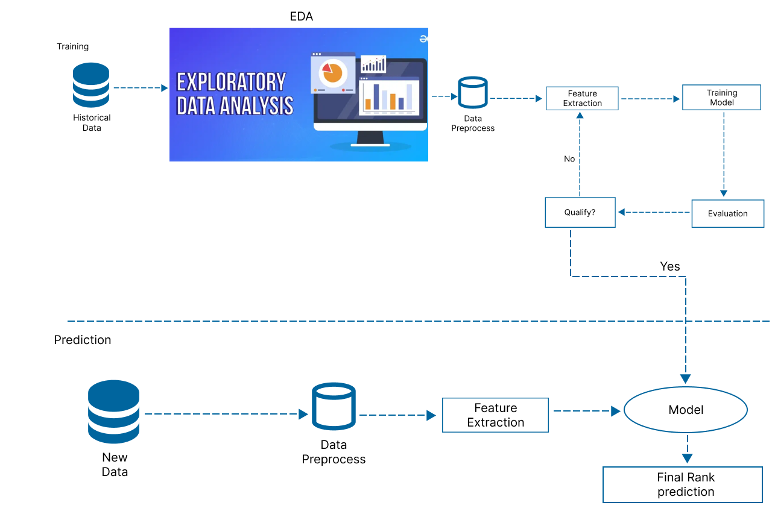
Methodology

Slide 10
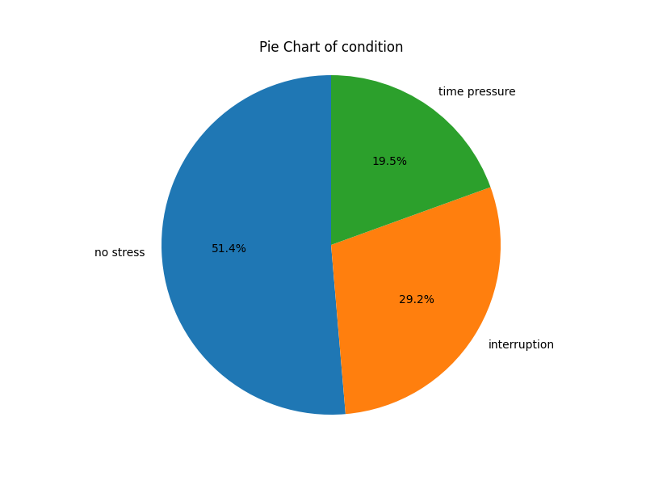
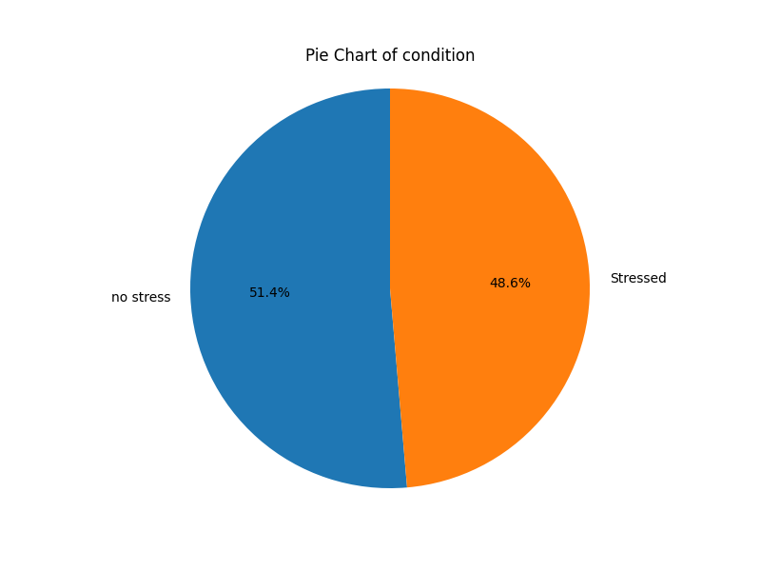
PIE CHART
combining “time pressure” and “interruption” as stressed

Slide 11
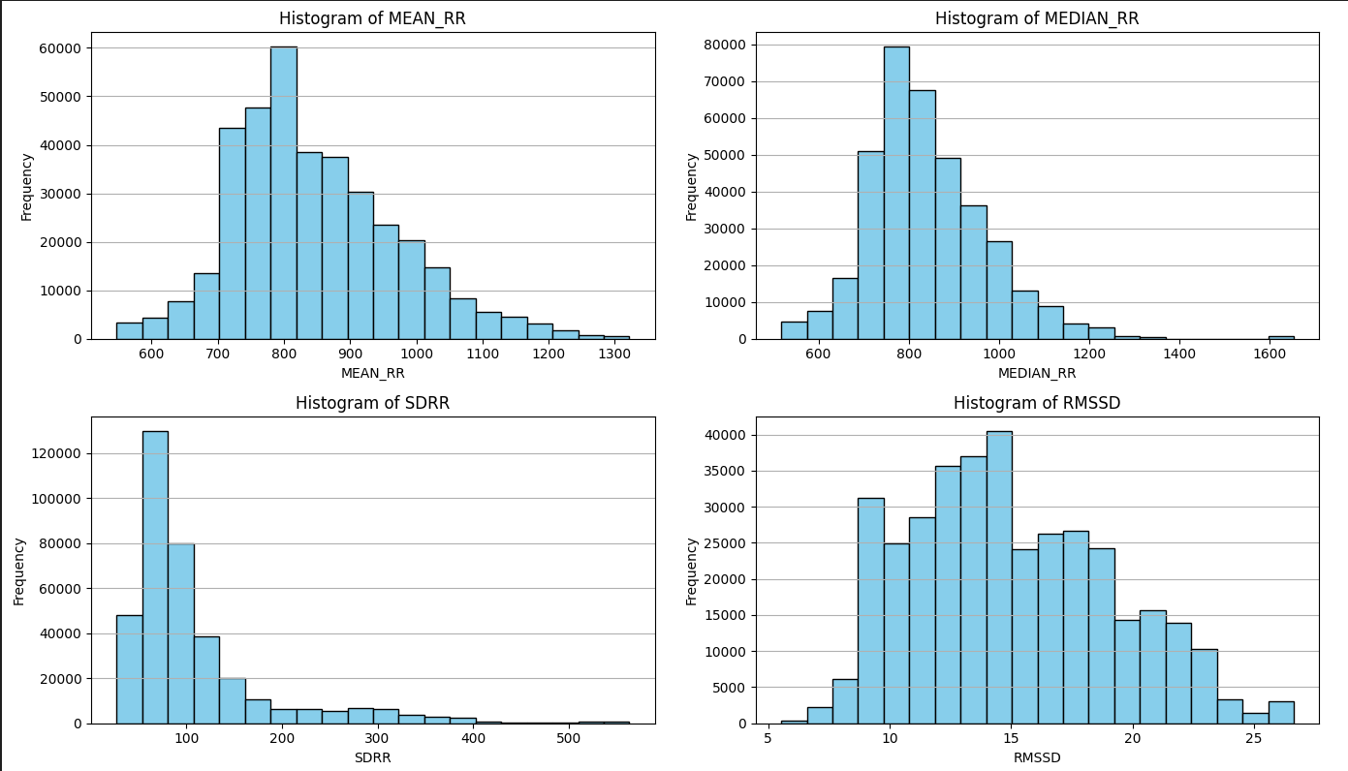
Histograms

Slide 12
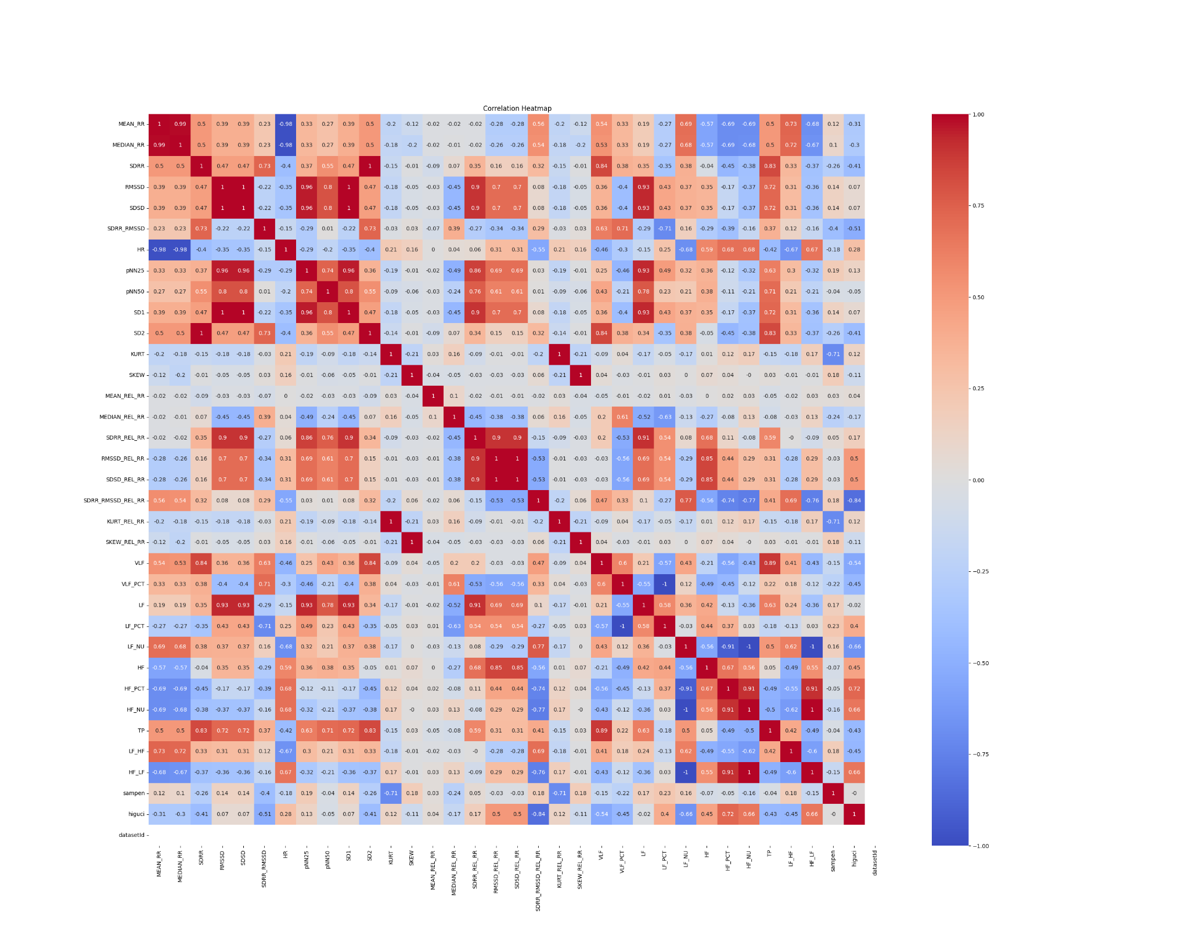
Heatmaps
Understanding Heatmap:
Some features exhibit correlations close to 0, indicating they provide independent and useful information.
Some features show strong positive or negative correlations, suggesting they could be combined or reduced to create a more independent and meaningful feature.

Slide 13

Preprocessing
Missing Data: Handle missing sensor values.
Normalization: Normalize physiological signals.
Outlier Removal: Detect and remove data outliers.
Conduct t-test: Determines the critical t-value for a two-tailed test at a 0.05 significance level and conducts t-tests.
PCA: Reduce 34 feature to 24 features.

Slide 14
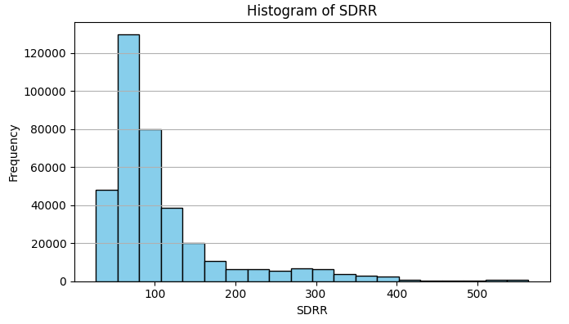
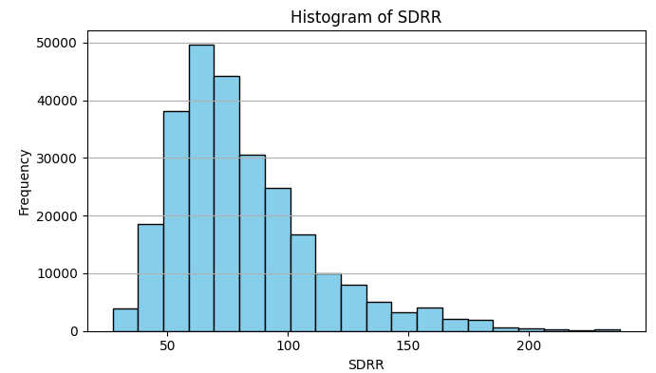
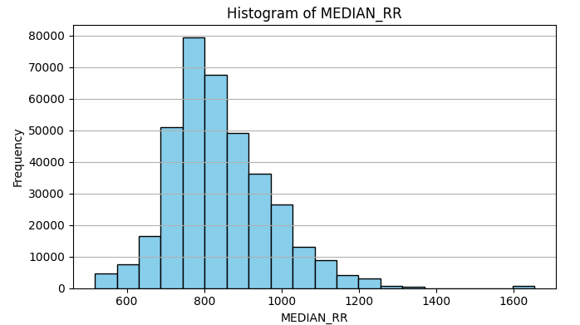
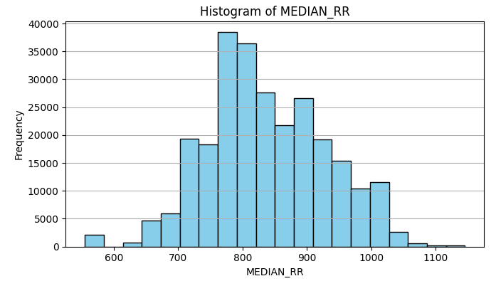
Outlier removal

Slide 15
Preprocessing
Feature Combination:
RMSSD_SDSD = (RMSSD + SDSD) / 2
KURT_MERGED = (KURT + KURT_REL_RR) / 2
SKEW_MERGED = (SKEW + SKEW_REL_RR) / 2
RMSSD_SDSD_REL_RR = (RMSSD_REL_RR + SDSD_REL_RR) / 2
PCA(Principal Component Analysis):
'MEAN_RR', 'MEDIAN_RR', 'HR', 'SDRR', 'SD2', 'VLF', 'TP', 'LF_NU', 'HF_PCT', 'HF_NU', 'HF_LF'
Combine these 11 features to get 3 PCA features
Final number of features - 22

Slide 16
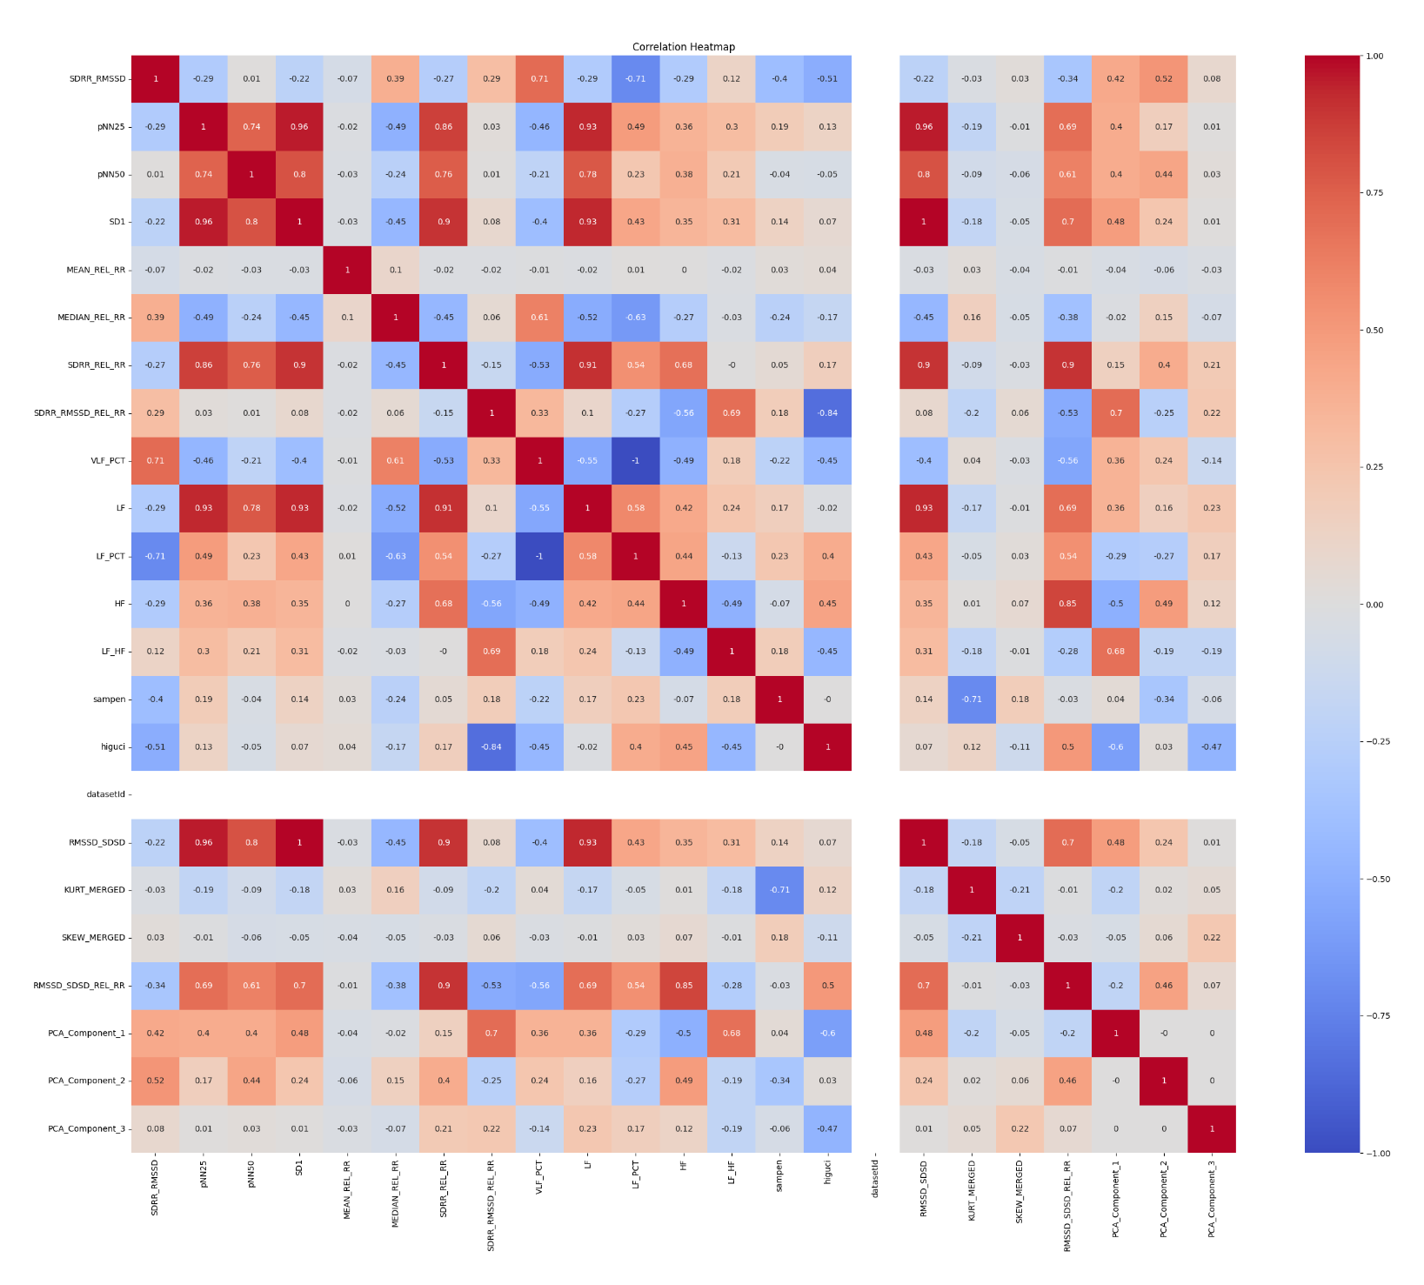
Applying PCA
Applying PCA and feature combination

Slide 17
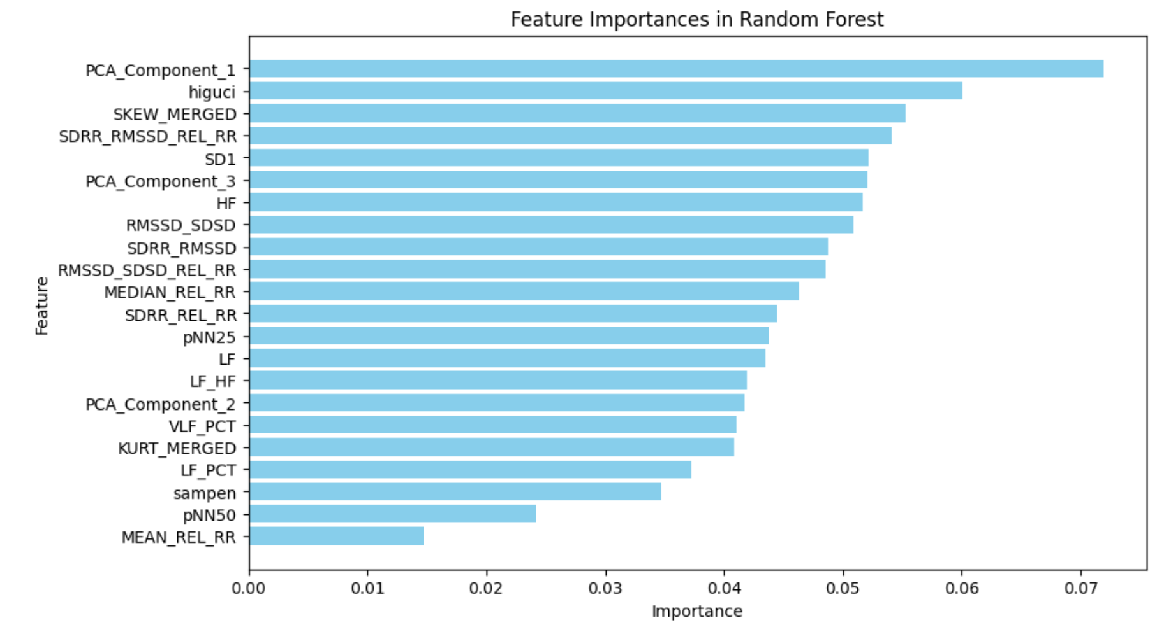
Feature Importance in Random Forest

Slide 18
Conclusion
Features | Logistic Regression | Decision Tree | Random Forest | Naive Bayes | Perceptron
Top 22 | 0.6509 | 0.865 | 0.9221 | 0.5708 | 0.5469
Top 20 | 0.6489 | 0.8662 | 0.9214 | 0.5689 | 0.518
Top 15 | 0.6119 | 0.8647 | 0.9219 | 0.5772 | 0.4804
Top 10 | 0.5939 | 0.8652 | 0.9215 | 0.5813 | 0.5597
Top 7 | 0.5771 | 0.8663 | 0.9234 | 0.5885 | 0.5058
Top 5 | 0.5788 | 0.8647 | 0.9226 | 0.5829 | 0.4434

Slide 19
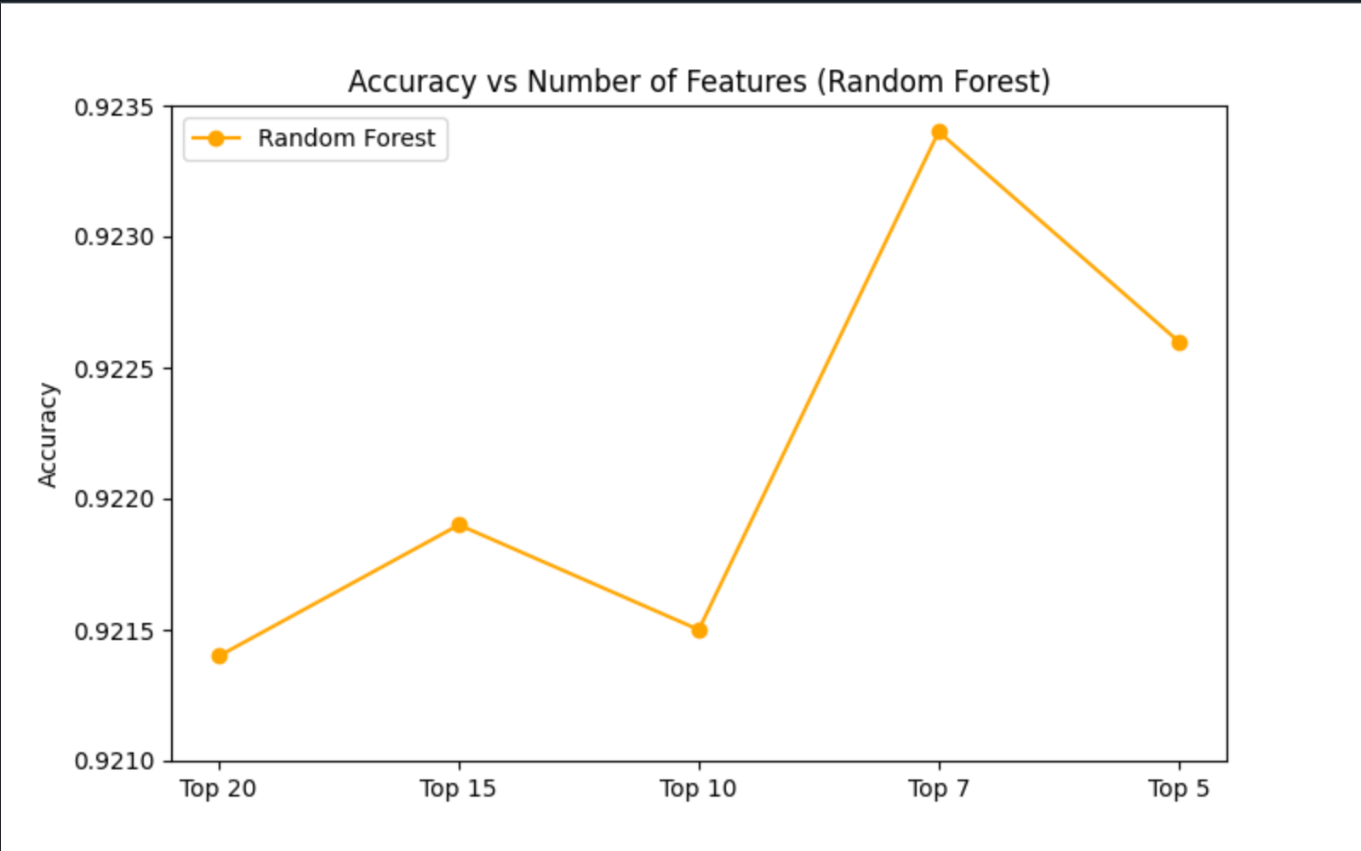
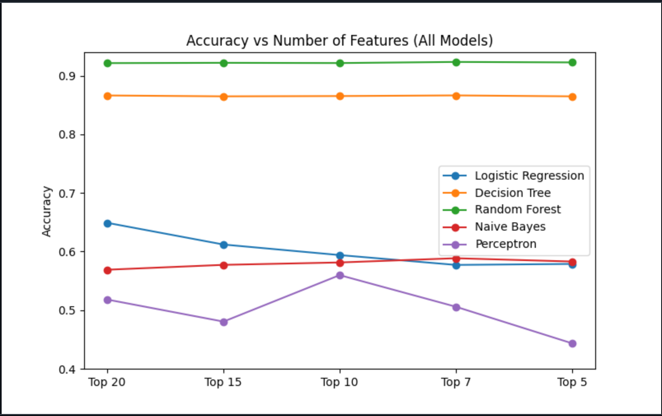
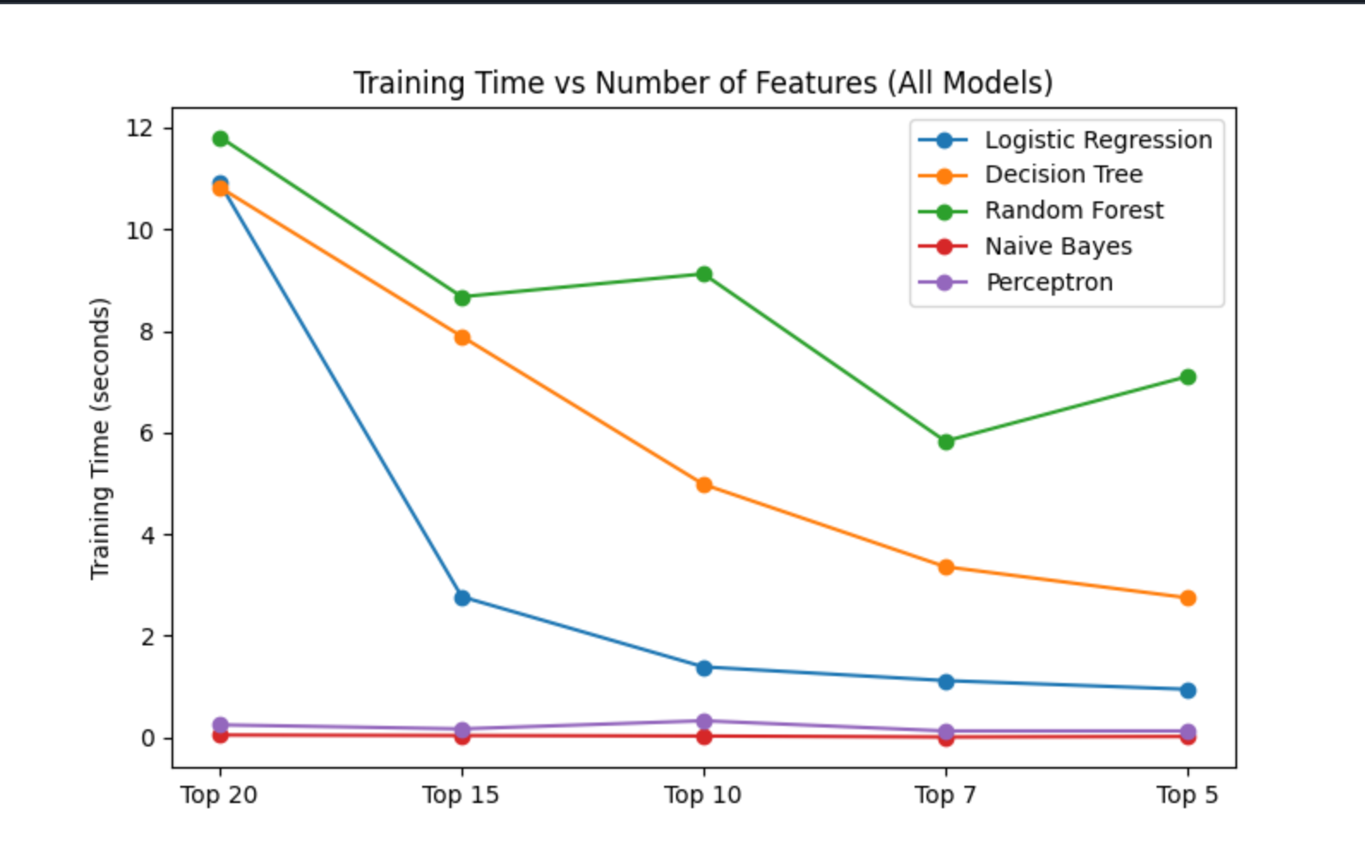
Conclusion

Slide 20
Analysing Results
Random Forest Performs Best:
Random Forest consistently outperforms the other models, especially with the top 7 features, achieving the highest accuracy of 0.9234.
This suggests that Random Forest benefits from using fewer, more important features.
Feature Reduction Effect:
As features are reduced, the performance of some models (like Logistic Regression and Naive Bayes) decreases slightly, but Random Forest maintains high performance.
Best Feature Count for Performance:
The best accuracy is achieved with the top 7 features for Random Forest and it takes the least time or computation.

Slide 21
Power Features
PCA_Component_1
higuci
SKEW_MERGED
SDRR_RMSSD_REL_RR
SD1
PCA_Component_3
HF

Slide 22
Timeline
Problem Understanding & Data Preprocessing
Model Development & Training
Deployment & Documentation
Week 3-4
Week 7-8
Week 1-2
Week 5-6
Week 9-10
Exploratory Data Analysis & Feature Selection
Model Testing & Validation

Slide 23
Individual Contribution
Namit Jain (2022315):- PPT creation, Programming
Saurav Haldar (2022464):- Report Creation, Programming
Saarthak Saxena (2022421):- Report Creation, Programming
Satwik Garg (2022461):- PPT creation, Programming

